Slide 1
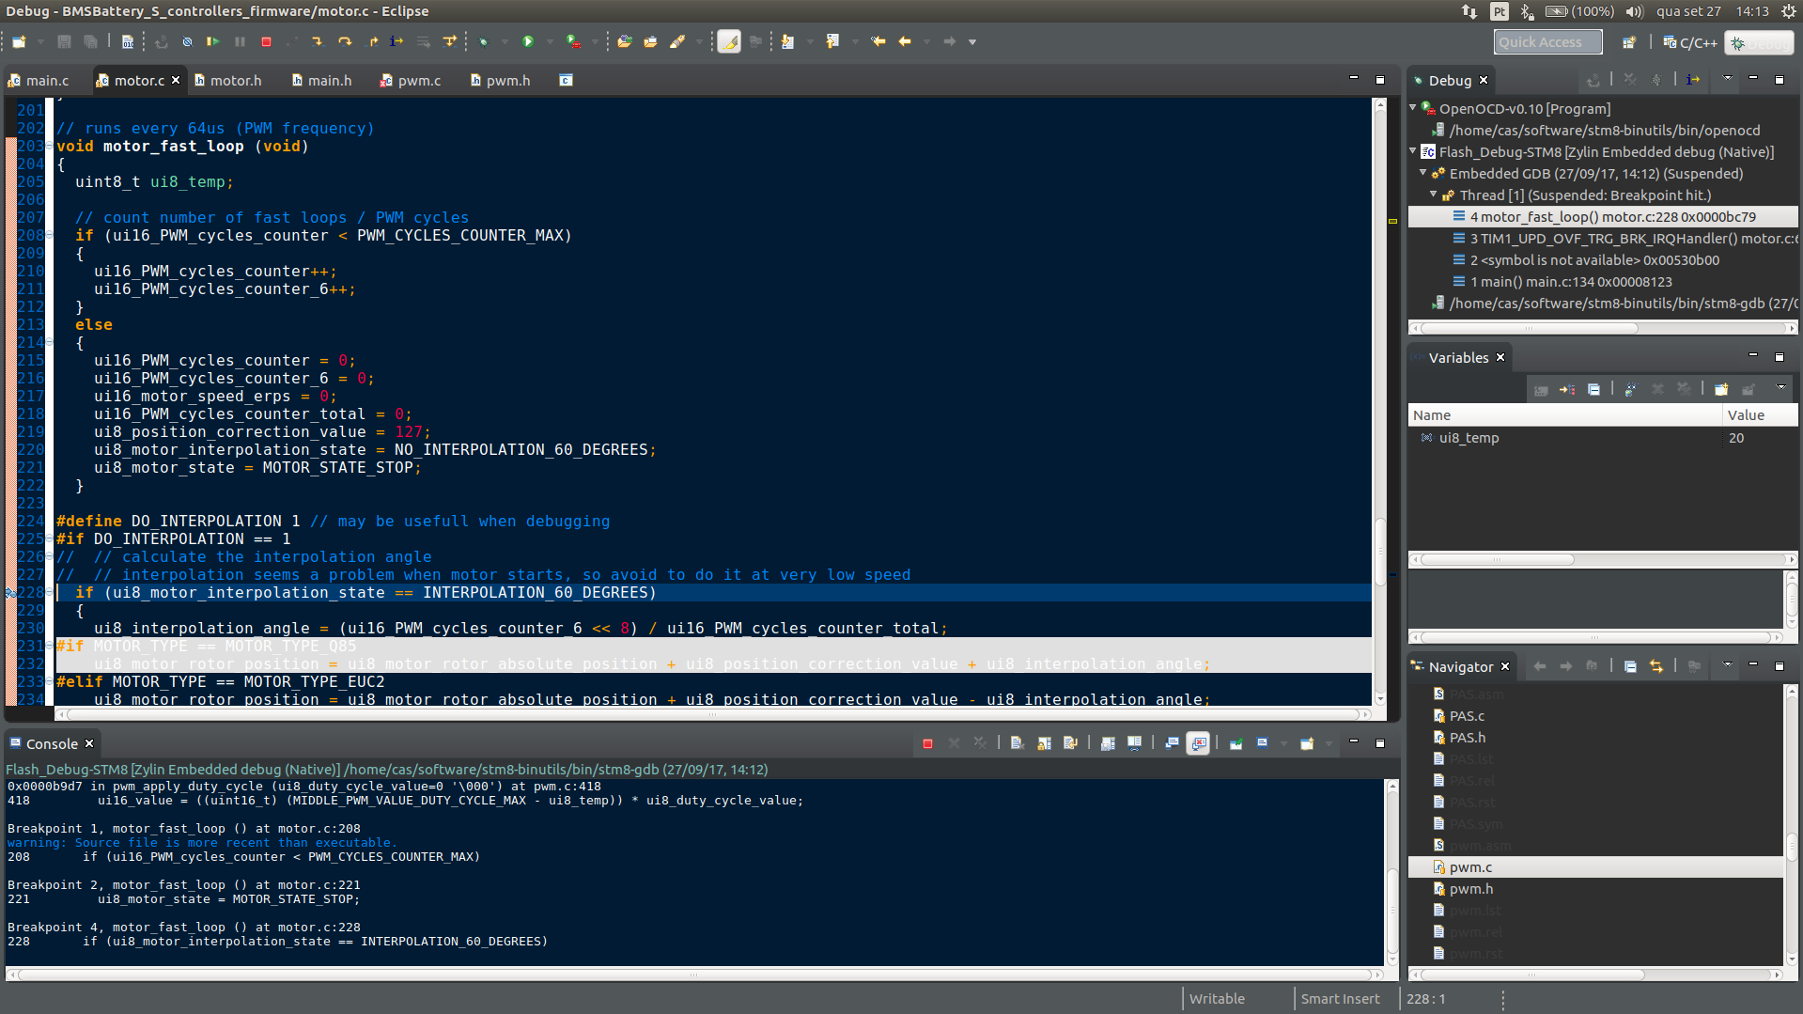
OpenSource Firmware for chinese electric ebike motor controllers

Slide 2
Contents
Motivation
Some electric vehicles
Principal components of an electric bicycle
Makers: what are they doing
Motor controller OpenSource firmware
Development tools
Firmware optimizations
Developers / community
Project status
Questions and answers

Slide 3
About me
Dad
<3 tecnhology and nature
OpenSource
Firmware, software and electronics
Co-founder of BEEVERYCREATIVE
Unemployed, that’s why I am being working full time on this project
https://github.com/casainho
https://www.linkedin.com/in/jorge-pinto-6411b118/
Notes:
- education in electronics / firmware / software
- BEEVERYCREATIVE: developed and put on the market the first Portuguese desktop 3D printer
- I am currently unemployed, looking for new oportunities and that’s why I am being working at full time on this hobby project

Slide 4

Motivation
Notes:
- actually, this is a grafitty from the famous Banksy

Slide 5

Motivation
Notes:
- Even Pope Francis, the catholics, they are worried about climate change and lobbying to influence politics

Slide 6
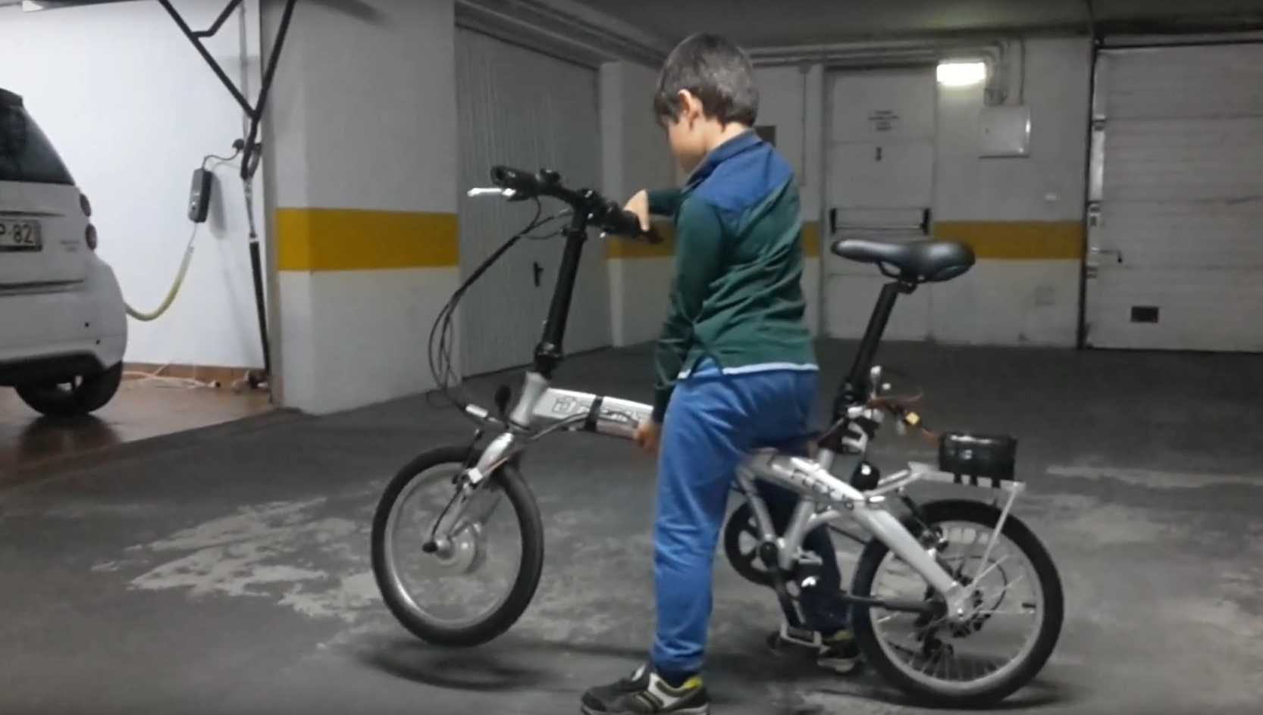
Motivation
Notes:
- my son of 7 years old, when I put his electric bike electric
- and he tried for the first a throttle and the torque/force, driving for the very first time his own vehicule

Slide 7
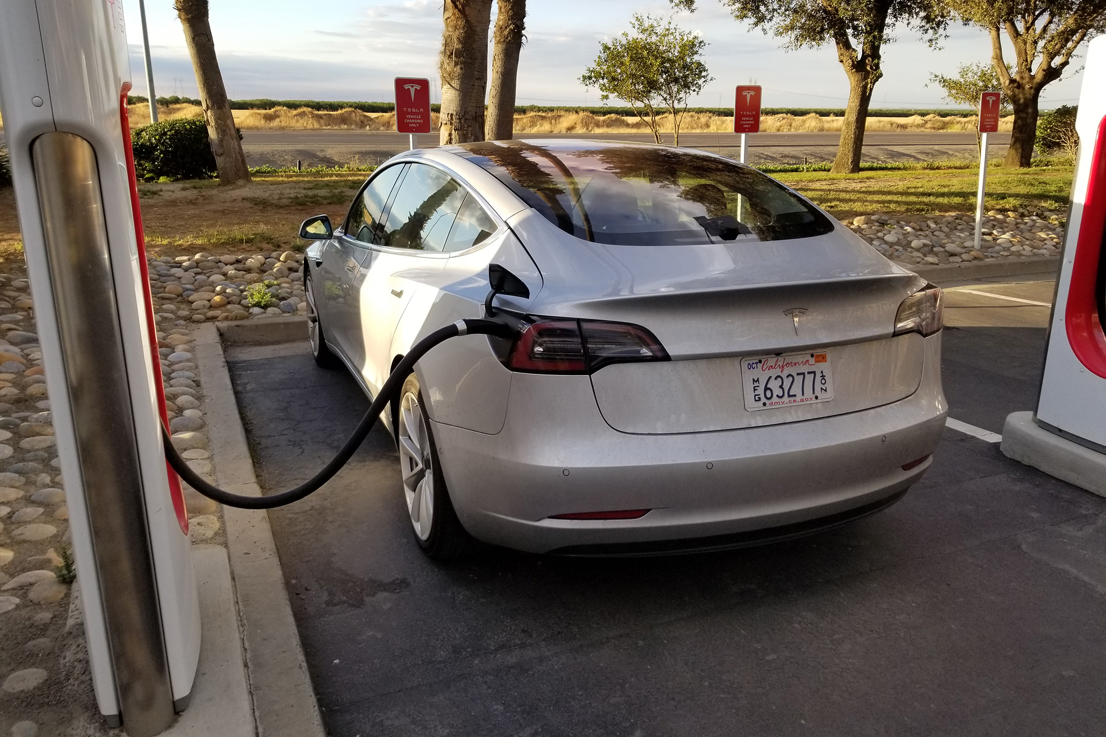
Electric vehicles

Slide 8
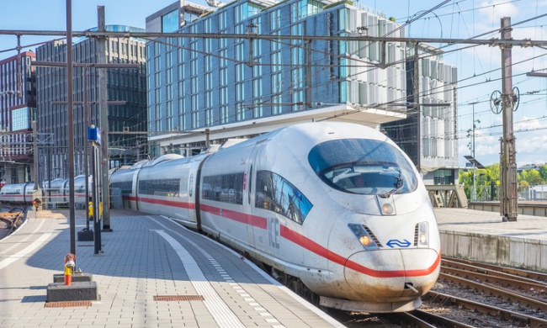
Electric vehicles

Slide 9
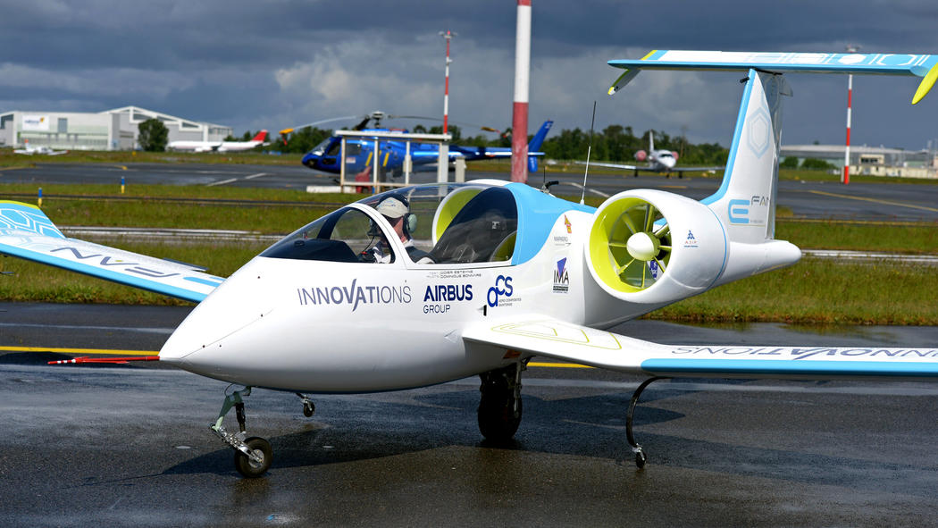
Electric vehicles

Slide 10
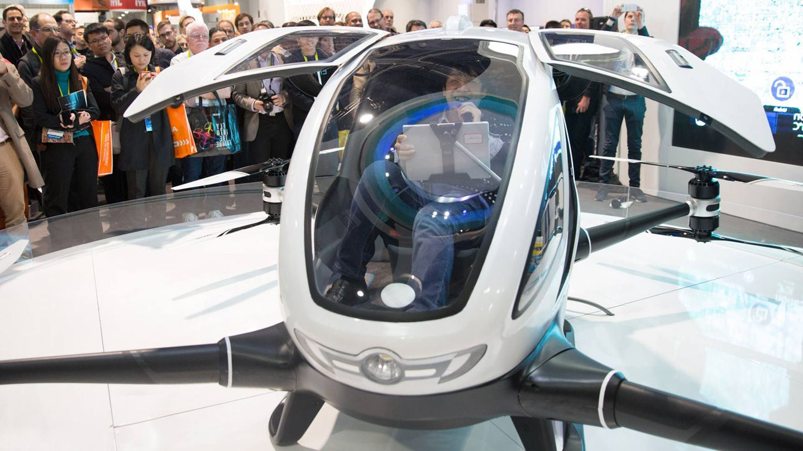
Electric vehicles
Notes:
- drones for personal transportation

Slide 11

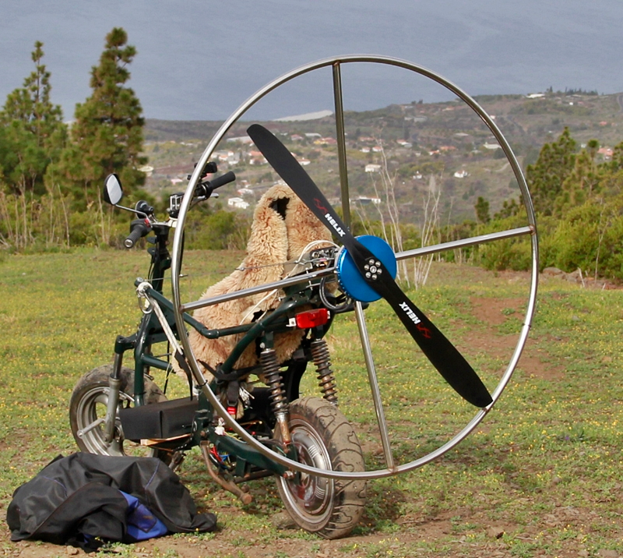
Electric vehicles
Notes:
- eletric scooter + electric paraglider
- this maker uses the scooter to go to the top of the montain, then he drives the scooter and launches from the top of the mountain to start the flying

Slide 12
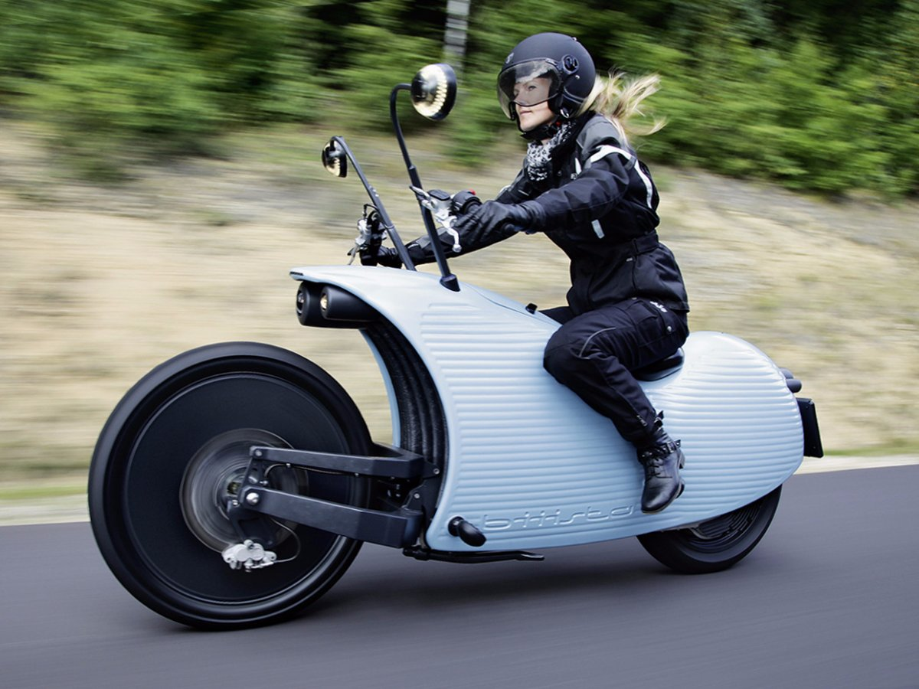
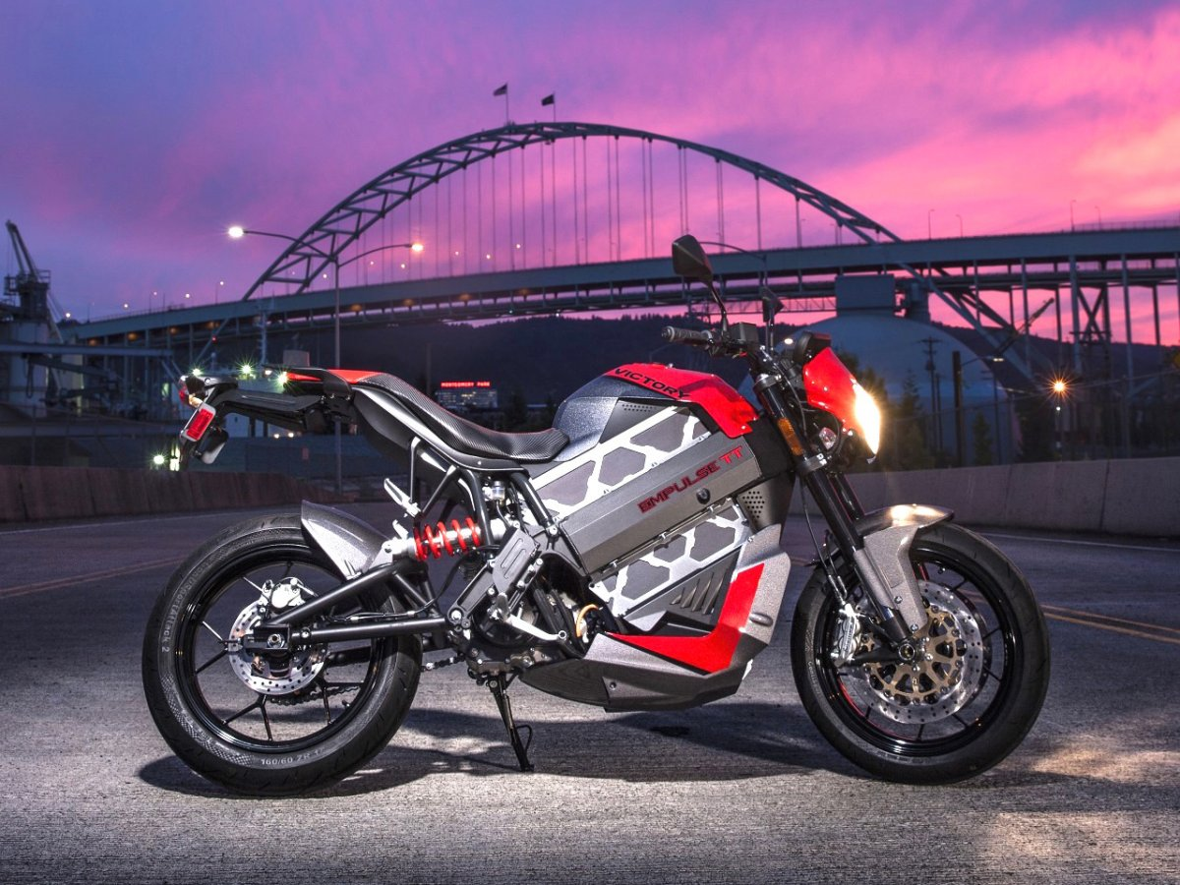
Electric vehicles

Slide 13
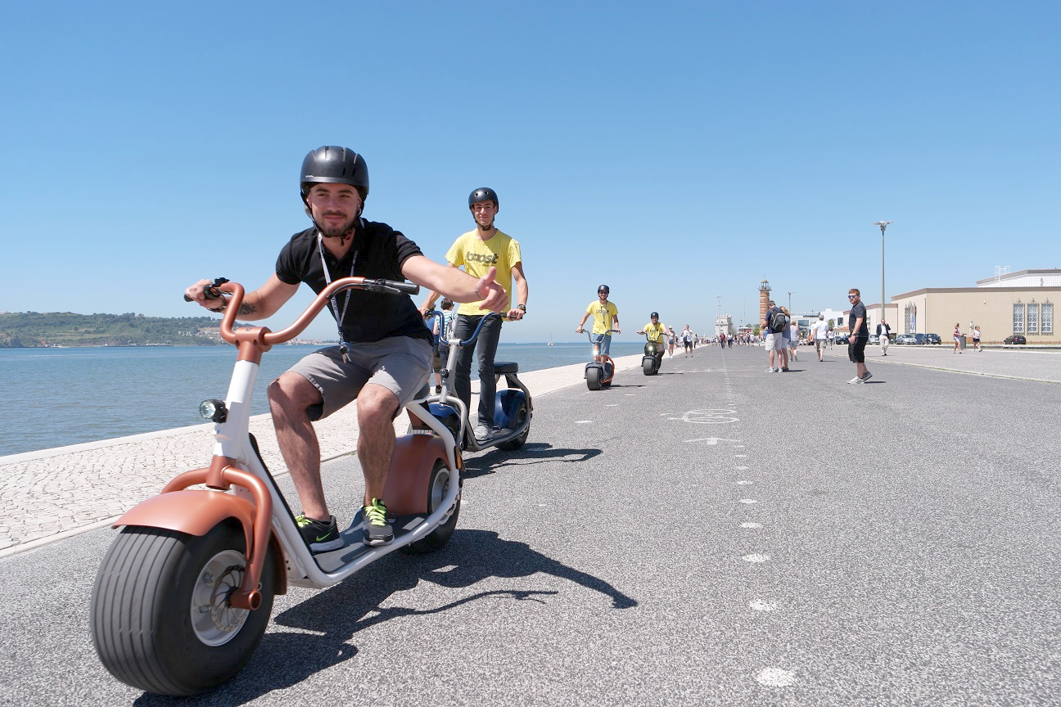
Electric vehicles

Slide 14
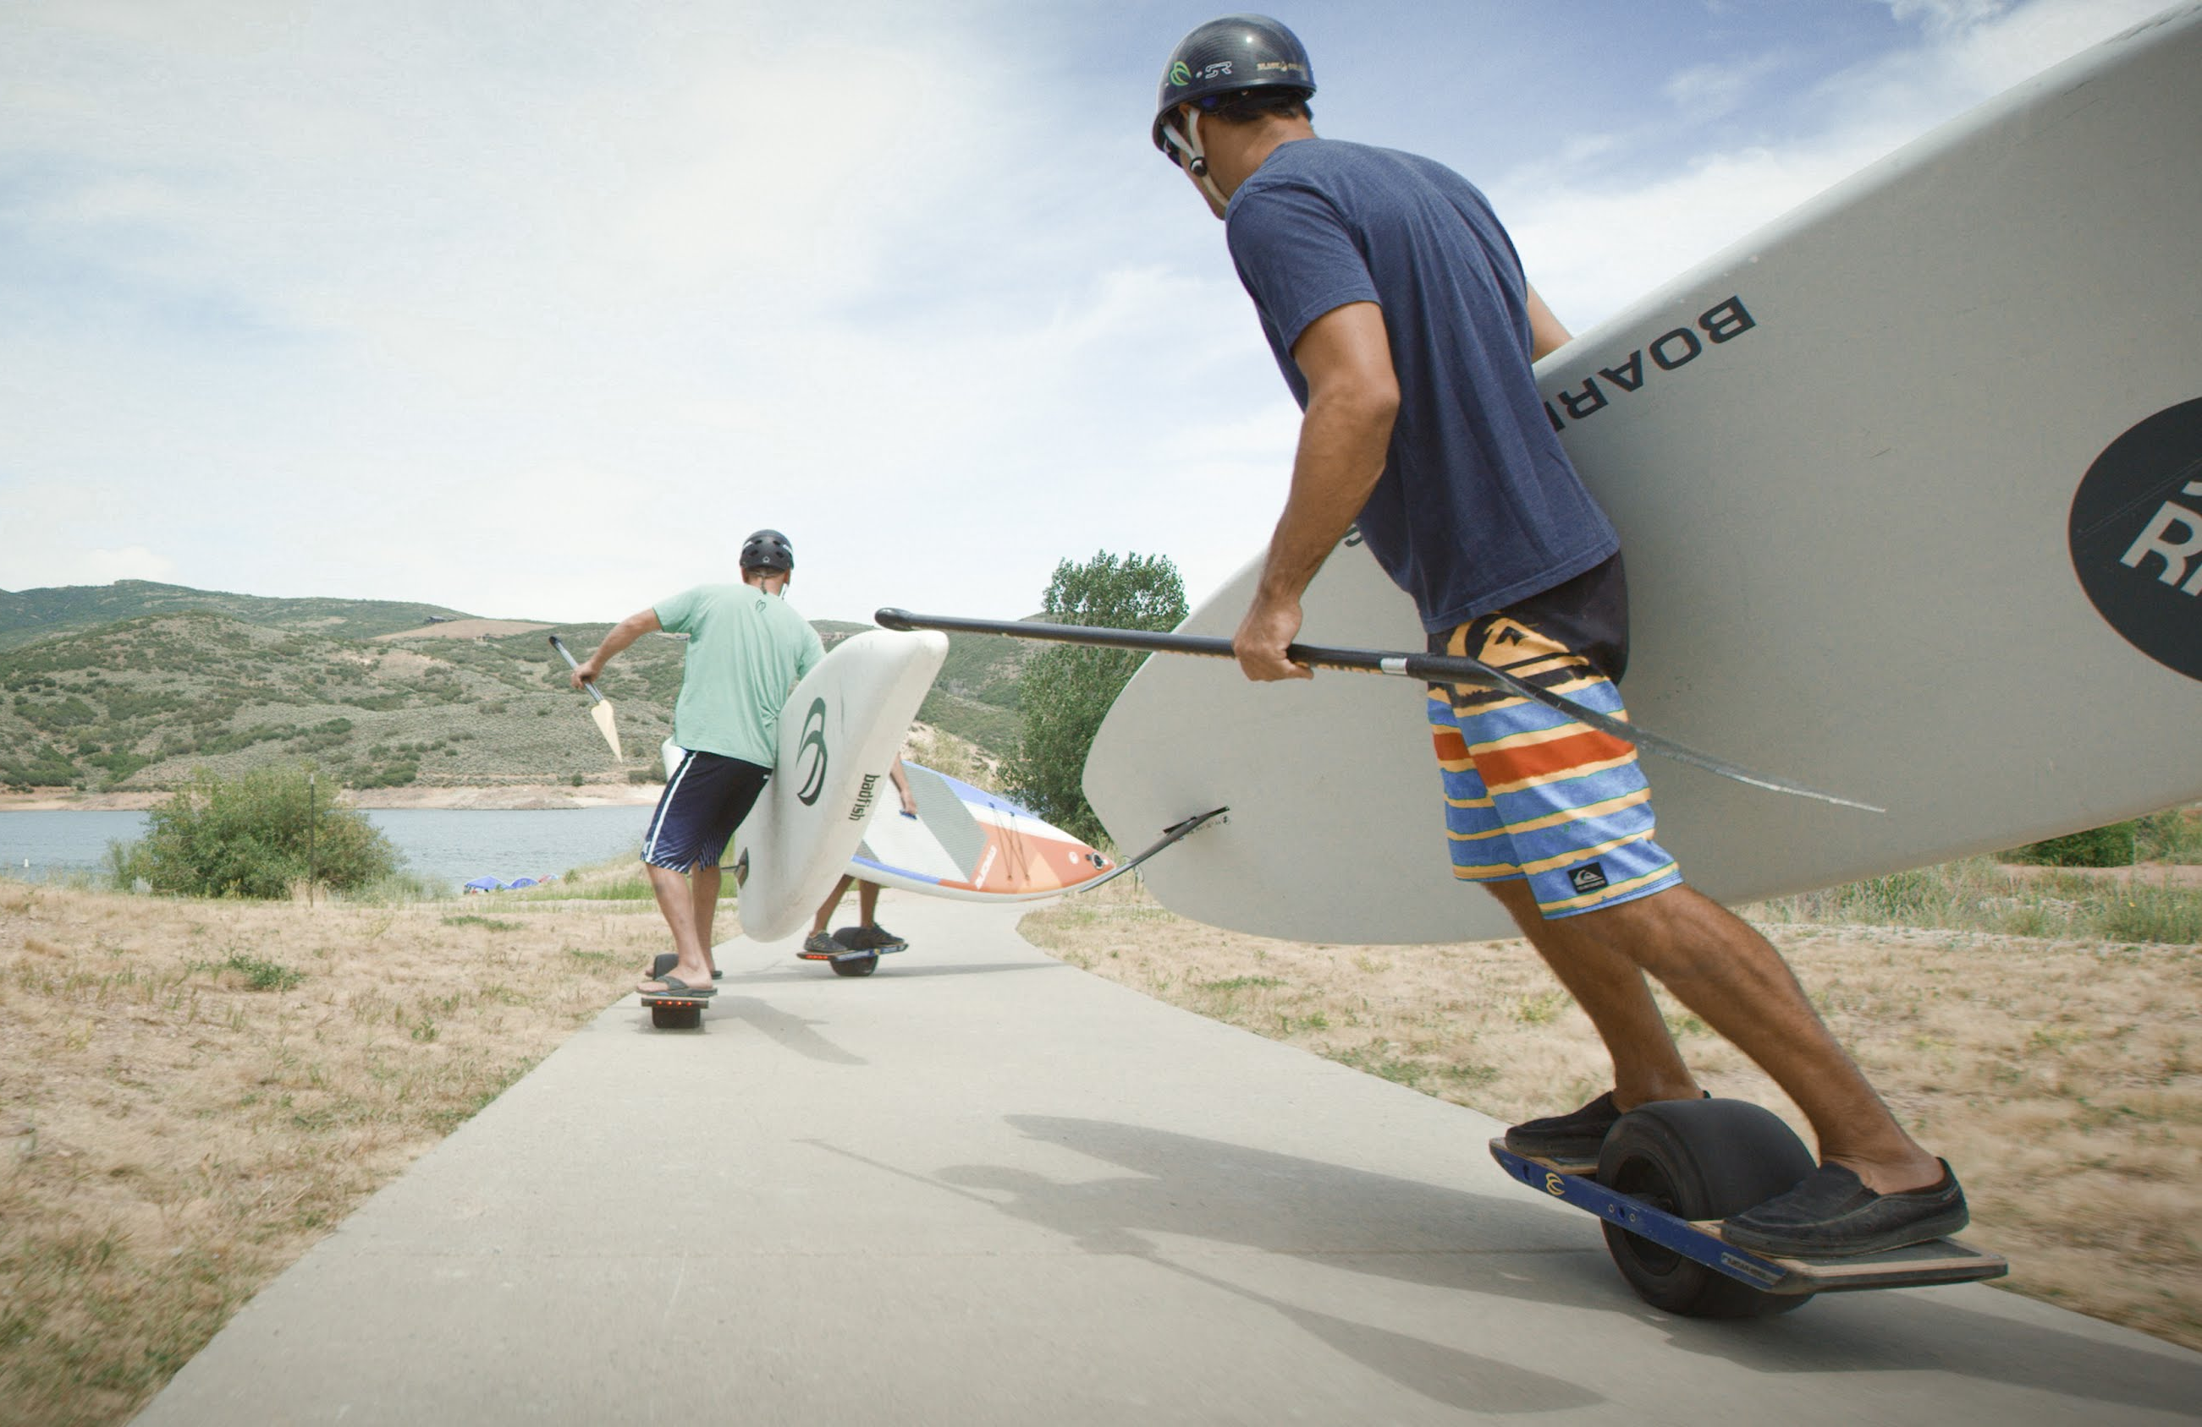
Electric vehicles
Notes:
- One wheel skate

Slide 15

Electric vehicles
Notes:
- electric skate / snowboard because if can move in 360º

Slide 16

Electric vehicles
Notes:
- Electric surfboard

Slide 17
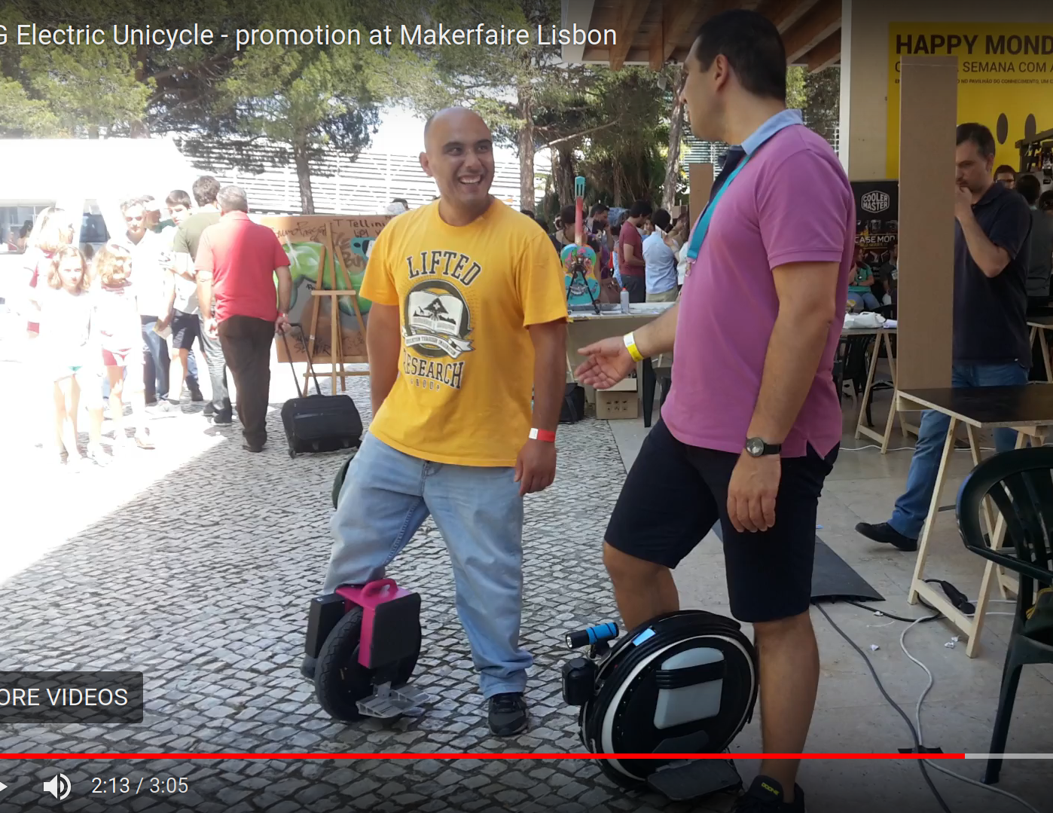
Electric vehicles
Notes:
- electric unicycles
- this vídeo was recorded on the Lisbon Makerfaire 2016

Slide 18
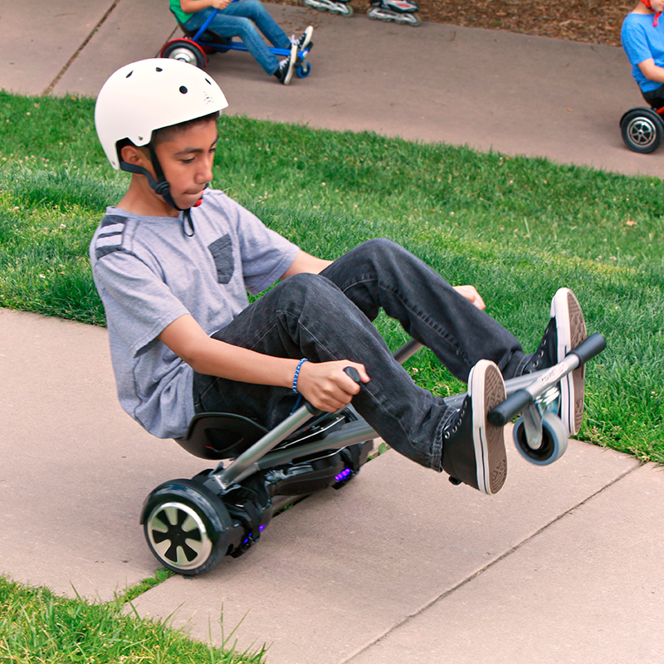
Electric vehicles
Notes:
- hoverboard + hovercart

Slide 19
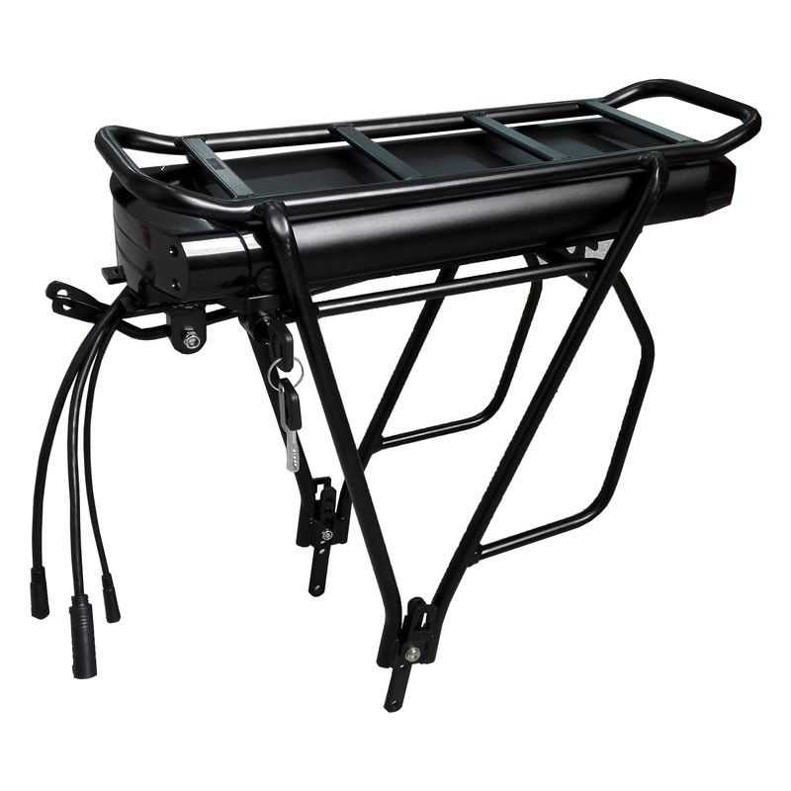
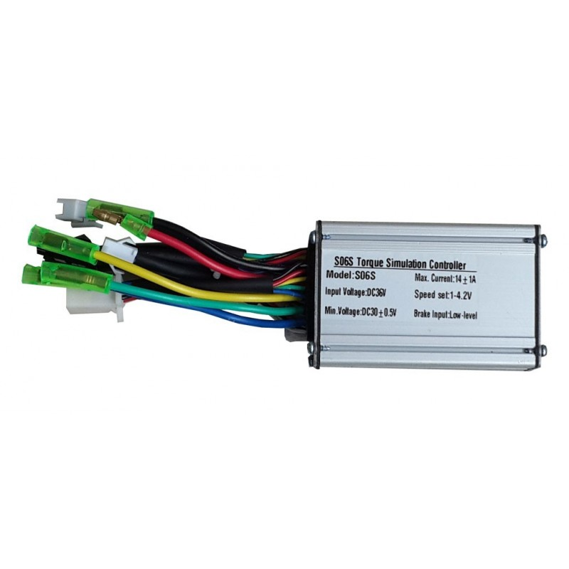
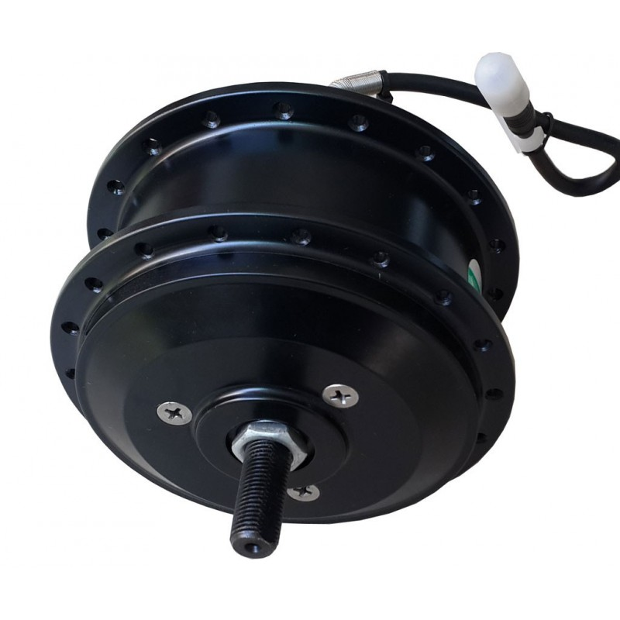
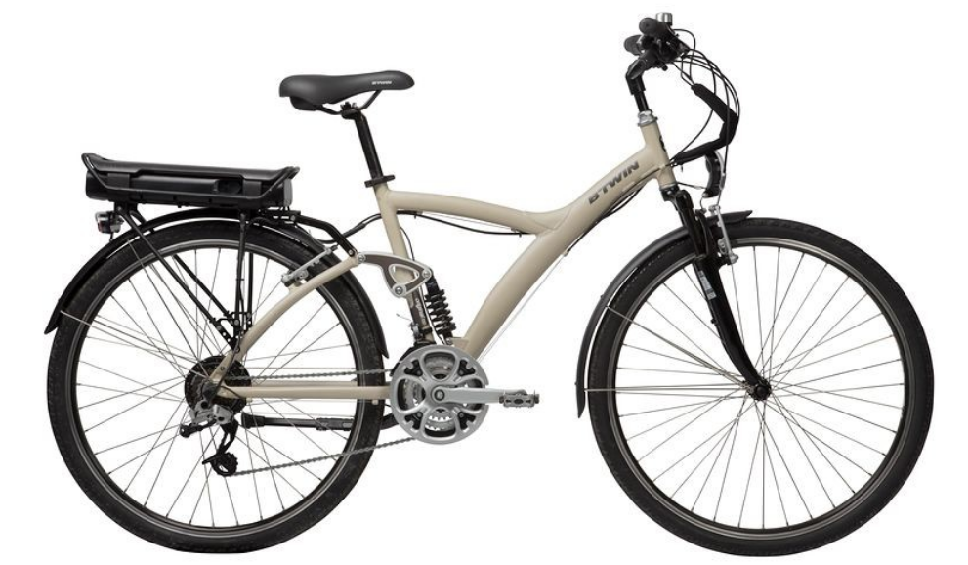
Electric bicycles
Bicycles are said to be the transportation of the future on the crowded cities
Notes:
1º brushless hub motor
2º battery pack
3º motor controller
Throotle and brakes

Slide 20
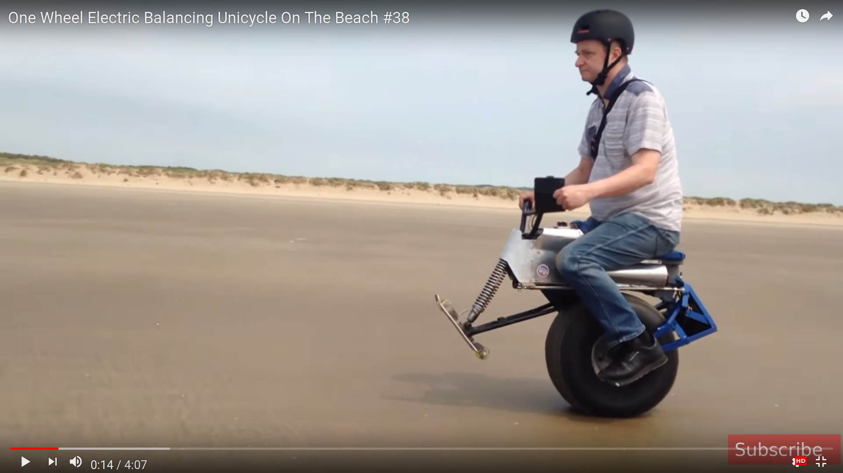
Makers: what are they doing
Notes:
- XenonJohn
- first balancing electric skate in 2009
- one wheel scooter

Slide 21
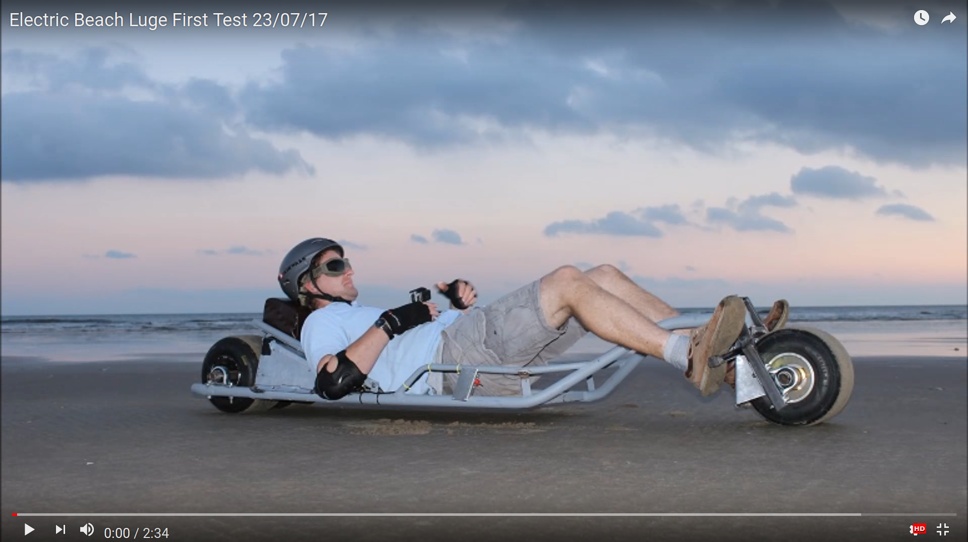
Makers: what are they doing

Slide 22
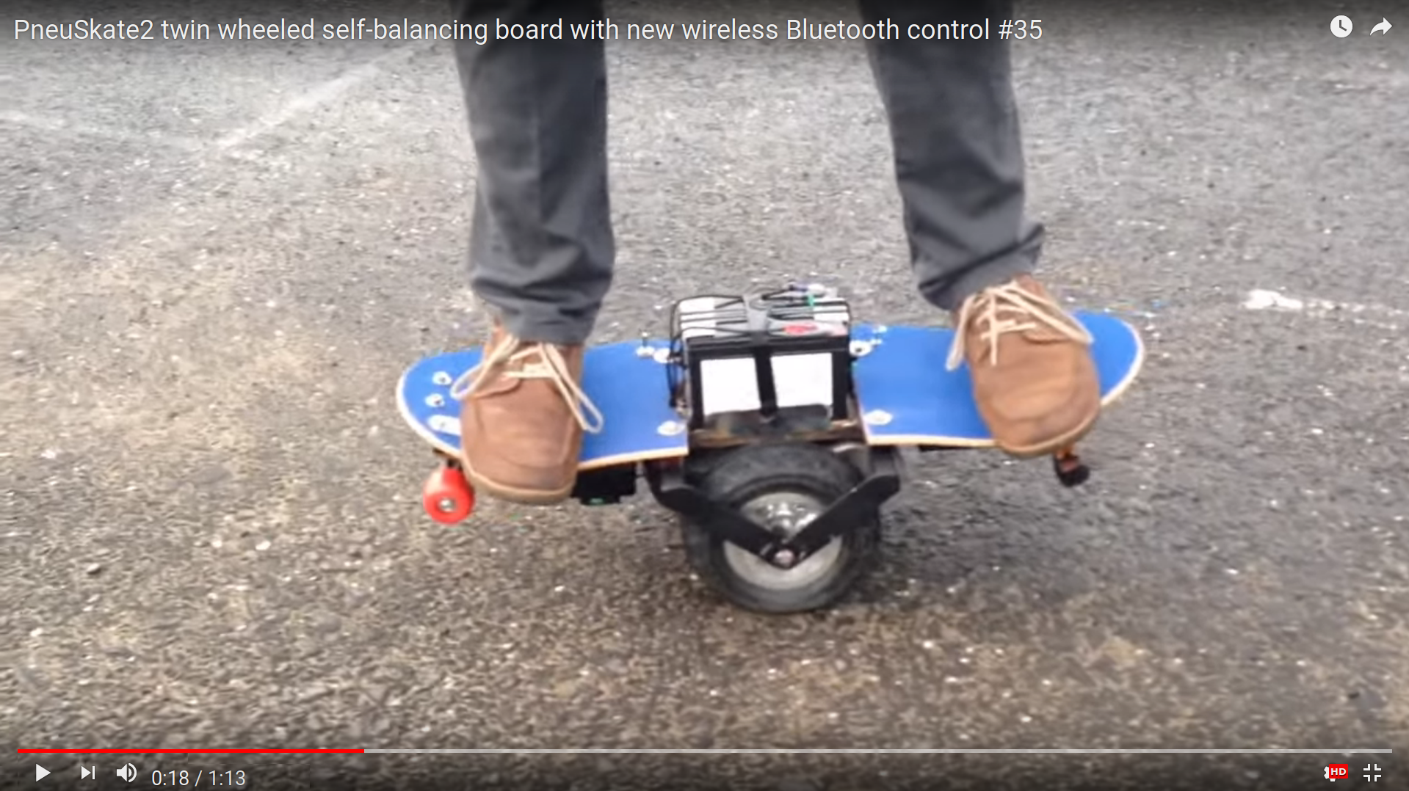
Makers: what are they doing

Slide 23
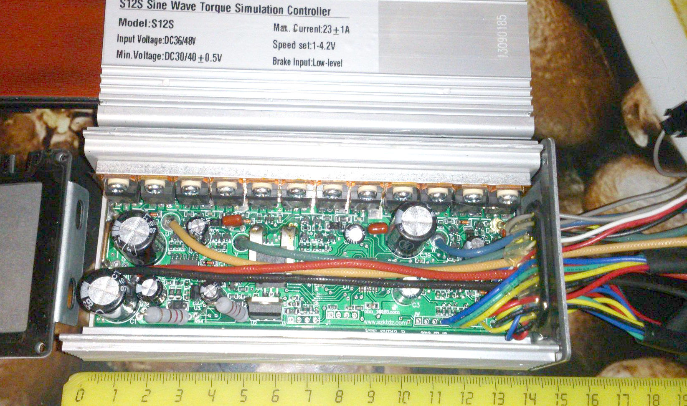
Hacking an ebike motor controllor
Notes:
- produced by a Chinse company with name Kunteng
- BMSBattery; online at least since 2009
- every online shop sell this controller, even with re-branding
- the most cheap motor controller on the market, starting from 16€
- well known programmable microcontroller

Slide 24
Hacking an ebike motor controllor
2010: 1st generation controllers
Are still available on the market
2015: 2nd generation controllers (BMSBattery S / Kunteng)
Same dirty cheap price - starting at 16€
More efficient: save battery energy; quiet motor
New: LCD or Bluetooh mobile app
Programable microcontroler, custom firmware <3
May be available on the next 7 years or more
Got a “thank you” from BMSBattery for helping on their brand awareness

Slide 25
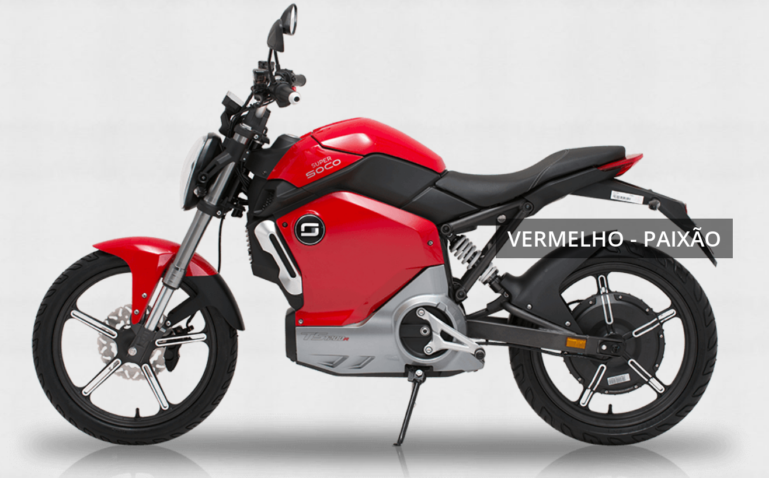
Hacking an ebike motor controllor
Sizes: 0.25KW to 4.3KW --> up to 100km/h
Notes:
http://supersoco.pt

Slide 26
Makers: what are they doing
Arduino community:
Balance things using DC motors, which are bigger, heavier and expensive, only because there is no brushless motor driver
Idea: 2nd generation controller firmware as a generic motor controller, using UART commands from Arduino
Custom features: quick invert rotation direction, etc
Notes:
- Arduino changed the world
- Objectivs of this project:
– highly configurable and flexible OpenSource firmware for Ebikes application
– generic brushles motor controller for Arduino and controlled using UART commands

Slide 27
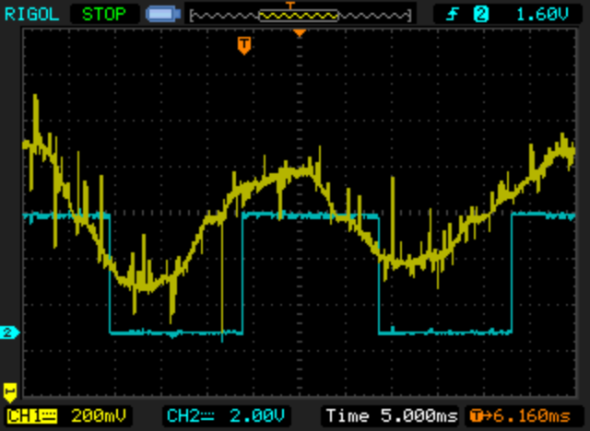
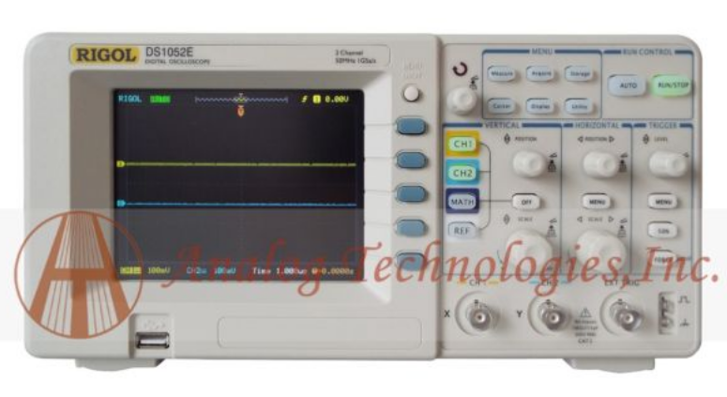
Hardware development tools
Oscilloscope
Ebay, Chinese, cheap: 270€
Digital; 50MHz and can store screenshots on USB flash disk
Notes:
- see and learn the signals on the circuit
- debug the firmware, by changing an IO pin of the microcontroller

Slide 28

Hardware development tools
Adjustable power supply
Ebay, Chinese, cheap: 30€
Notes:
- important for protect the short-circuits done during the develpment, that are always happening – the motor use a lot of energy; any short-circuit would destruct the controller
- I had already to repair for dead mosfets, probably due to a short-circuit

Slide 29
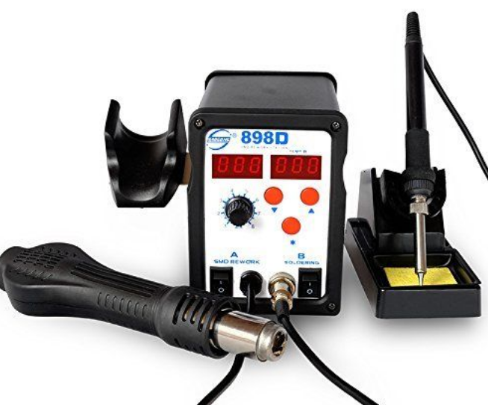
Hardware development tools
Solder station hot air
Ebay, Chinese, cheap: 50€

Slide 30
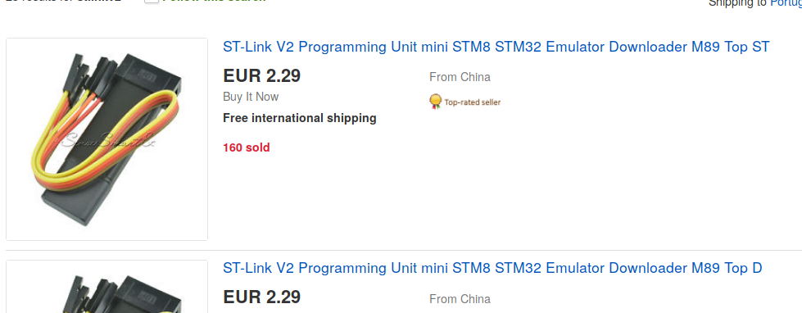
Hardware development tools
STM8 microcontroller programmer and debugger
Ebay, Chinese, cheap: 3€
Notes:
- this is a chinese clone of the original programmer/debugger and that is why is so cheap – works very well and it is really important to have cheap development tools or will not be possible to attract new developers for the project

Slide 31
Software development tools
C compiler: OpenSource and free SDCC
IDE: Eclipse (includes debugging)
Notes:
- available for Linux, MAC and Windows
- terminal or using Eclipse

Slide 32
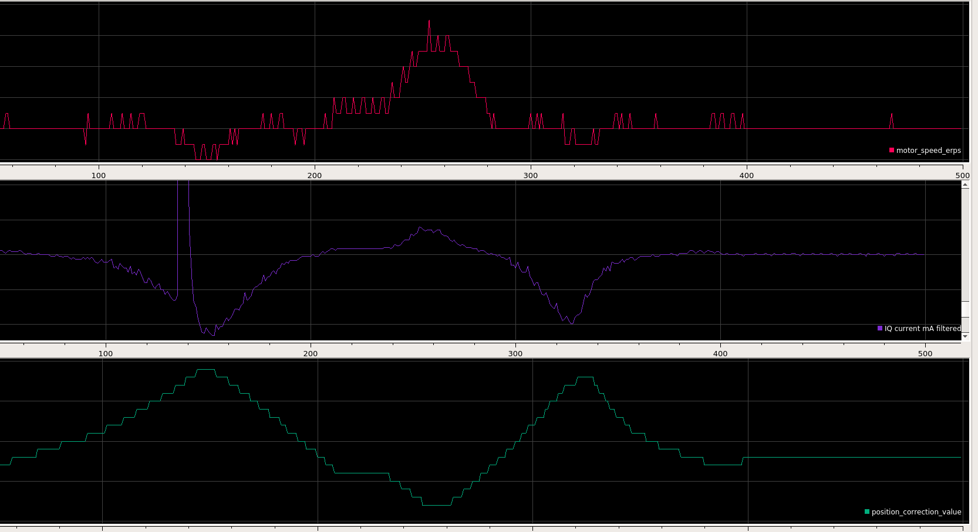
Software development tools
Realtime plotting from UART: Serialplot – OpenSource and free
Notes:
- available for Linux, MAC and Windows

Slide 33
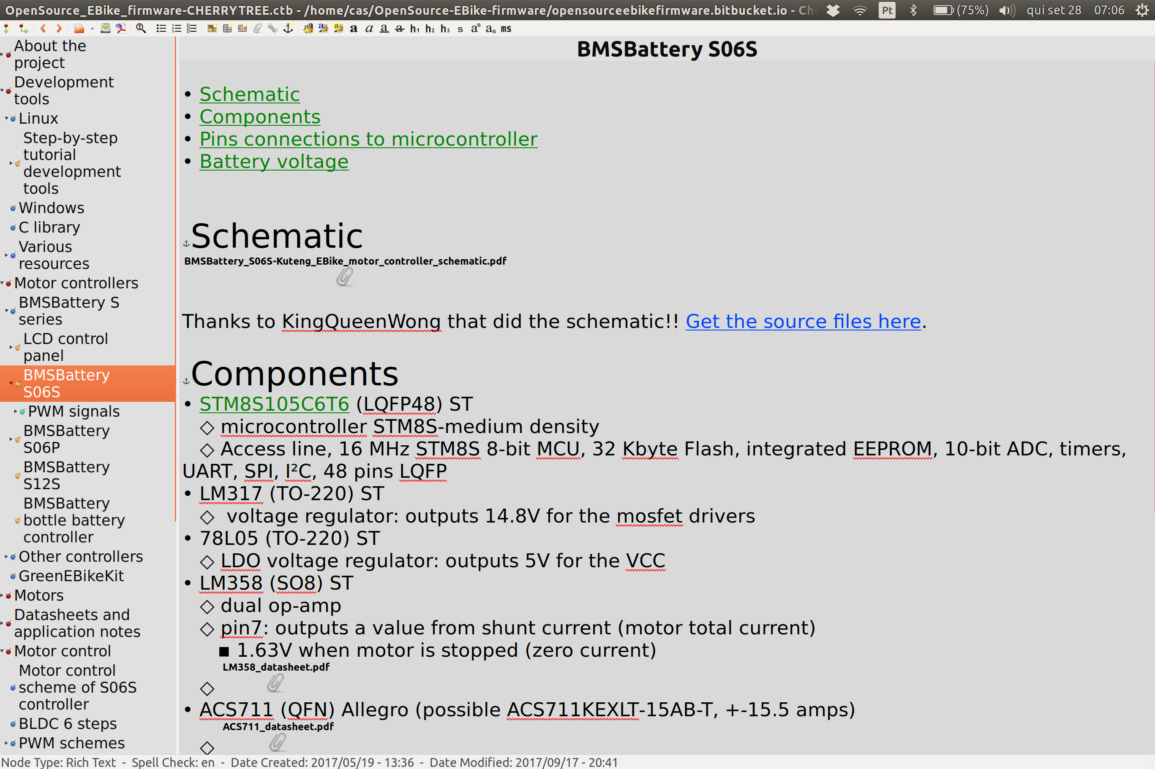
Software development tools
Note taking software for documentation: CherryTree OpenSource and free
Notes:
- available for Linux, MAC and Windows
- project documentation and sharing the knowledge is a priority on this project
- With CherryTree I can very quick copy-paste files and screenshots that are shared by users on the forum
- I am exporting the notes file to HTML that I upload to https://opensourceebikefirmware.bitbucket.io/

Slide 34
Firmware optimizations
Hoverboard STM32F103
32bits; 72MHz; hardware mul and div; DMA
Ebike Kunteng
8bits; 16MHz; no hardware mul and div; no DMA
Optimizations
try to always use 8 bits variables; loosing resolution on ADC
no float point operations: <<8 right shift values
avoid multiplications and divisions: using right/left shift operations
ui8_interpolation_angle = (ui16_PWM_cycles_counter << 8) / ui16_PWM_cycles_counter_total;
variables with 8 bits like angle 256 instead of 360
ui8_motor_rotor_position = ui8_motor_rotor_absolute_position + ui8_interpolation_angle;

Slide 35
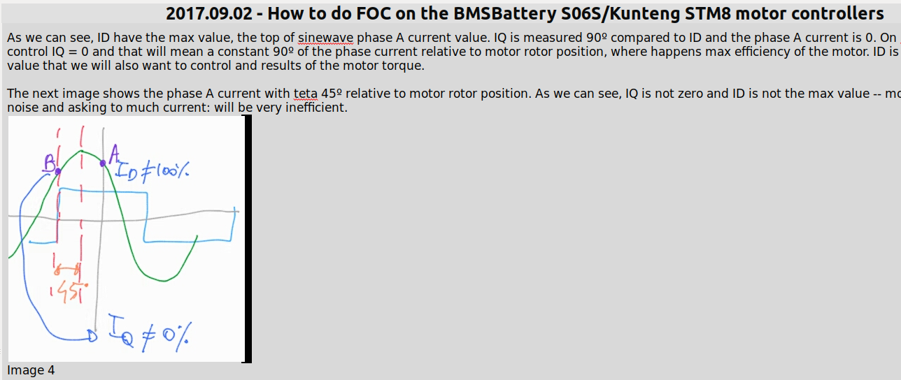
Very low resolution FOC
Field Oriented Control is the top technology of motor control
Chinese did a simplification → much more simple hardware and cheap!
Notes:
- Knowing FOC, that is the most advanced motor control tecnhology, I was able to understand the simplification the chineses developers did
- I wrote a document that is now available on the project documentation website, I couldn’t found any reference to this approach/simplification and I took some time to figure out

Slide 36
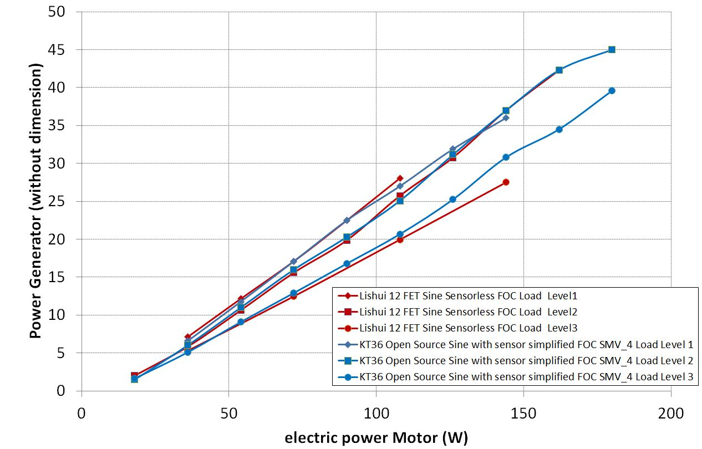
Very low resolution FOC
Same efficiency as original firmware and even real FOC controllers (although with some limitations)

Slide 37
Developers / community
https://endless-sphere.com/forums/
https://github.com/OpenSource-EBike-firmware
KingQueenWong: China; electronic engineer
Drawed the schematic
Found unavailable datasheet for a very specific microcontroller used on auto industry
Stancecoke: German; mechanical engineer
Implemented the feature/compatibility for torque sensor
Previous version for Arduino, to hack on top of 1st gen chinese controllers
Implemented software configurator
Implemented a test bench to benchmark our OpenSource firmware
Mantain a thread the German Pedelec forum
Njay: Portugal; Software engineer
Motor hardware
firmware optimizations for speed

Slide 38
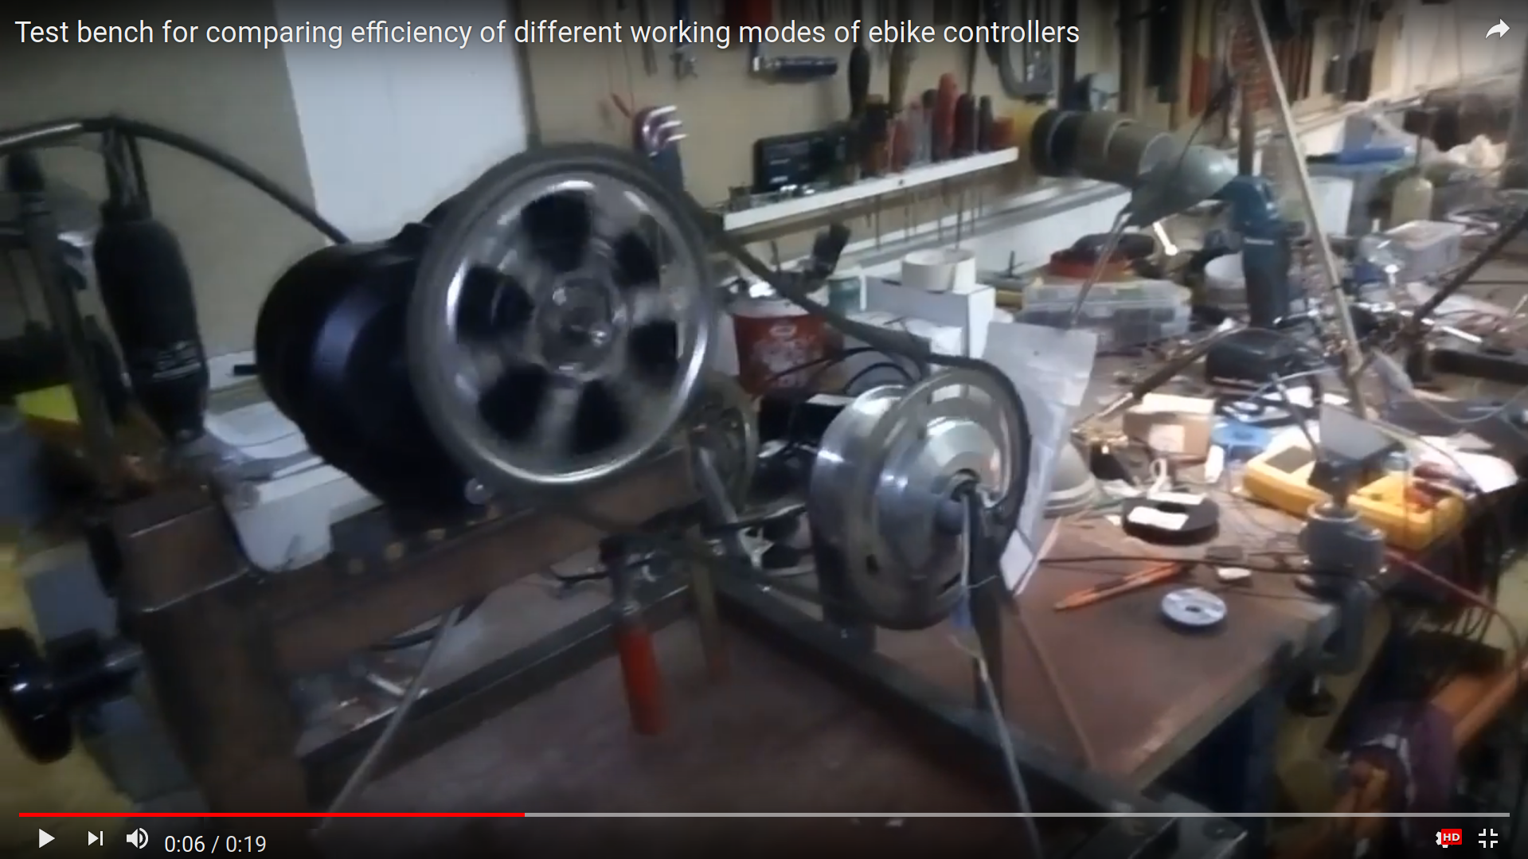
Developers / community
Stancecoke: test bench

Slide 39
Project status
Motor works
Same efficiency as original firmware
Regeneration
Max and over current protection
Battery voltage protection
Throttle, PAS and torque sensor(NEW!)
Max speed control
Software configurator
TODO
LCD / Bluetooth
EEPROM saving configurations
Stabilization

Slide 40
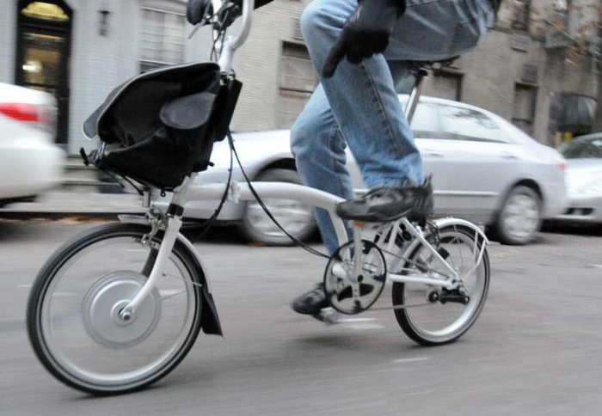
Thank you
Project page:
https://opensourceebikefirmware.bitbucket.io

